Slide 1


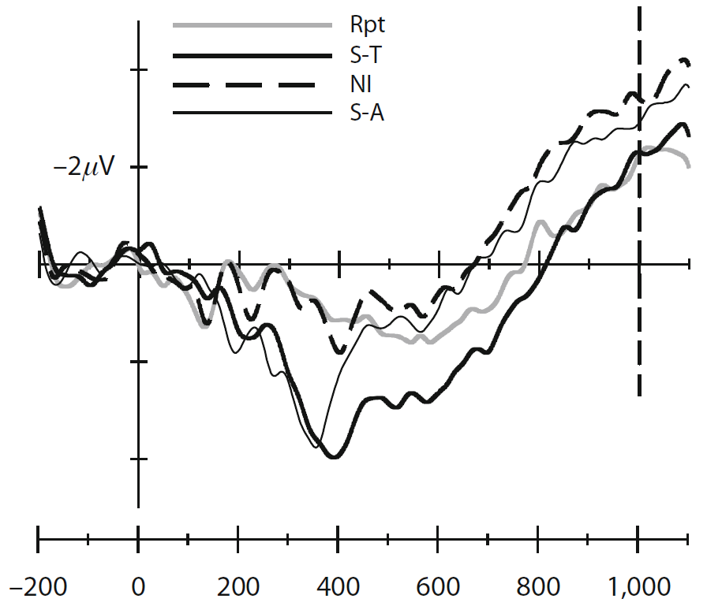

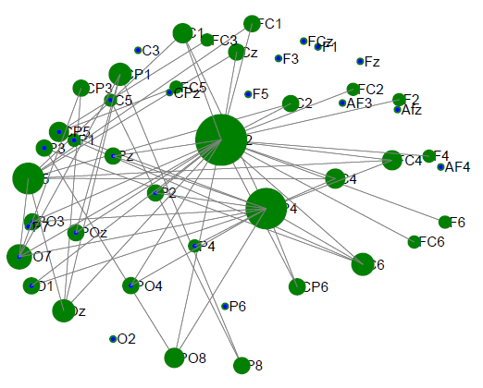
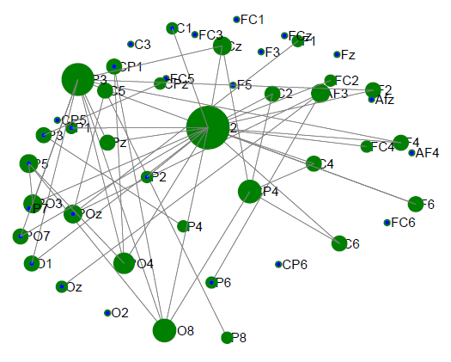
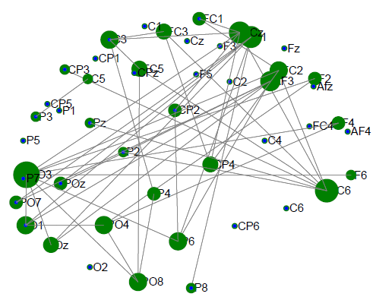
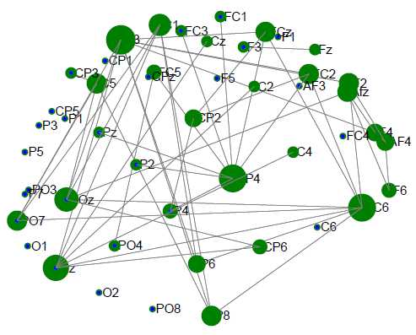
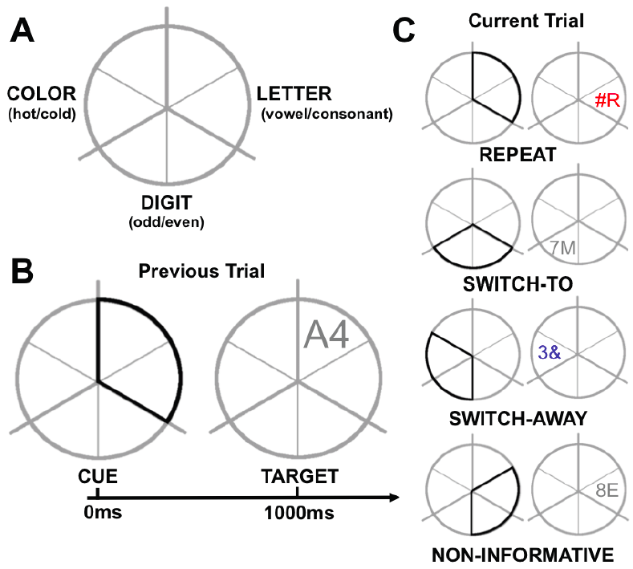
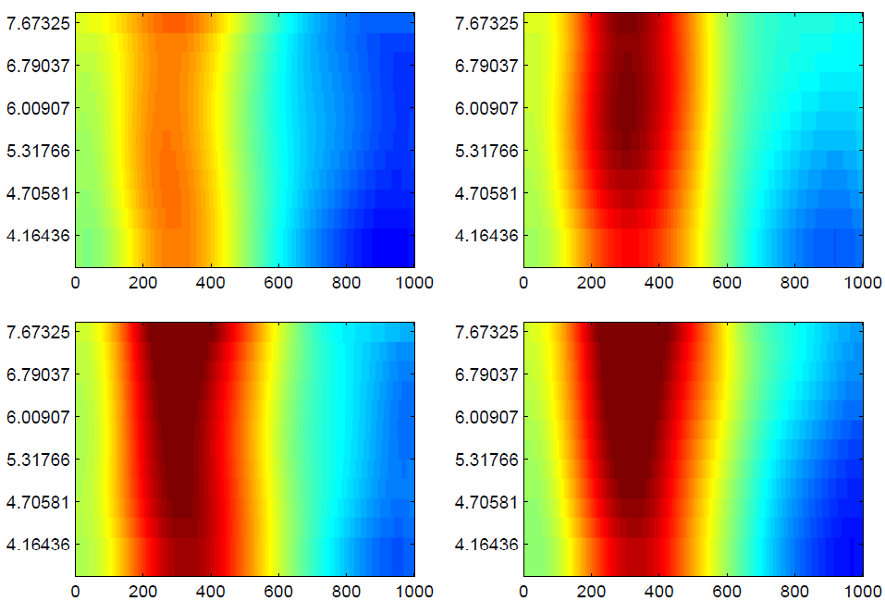
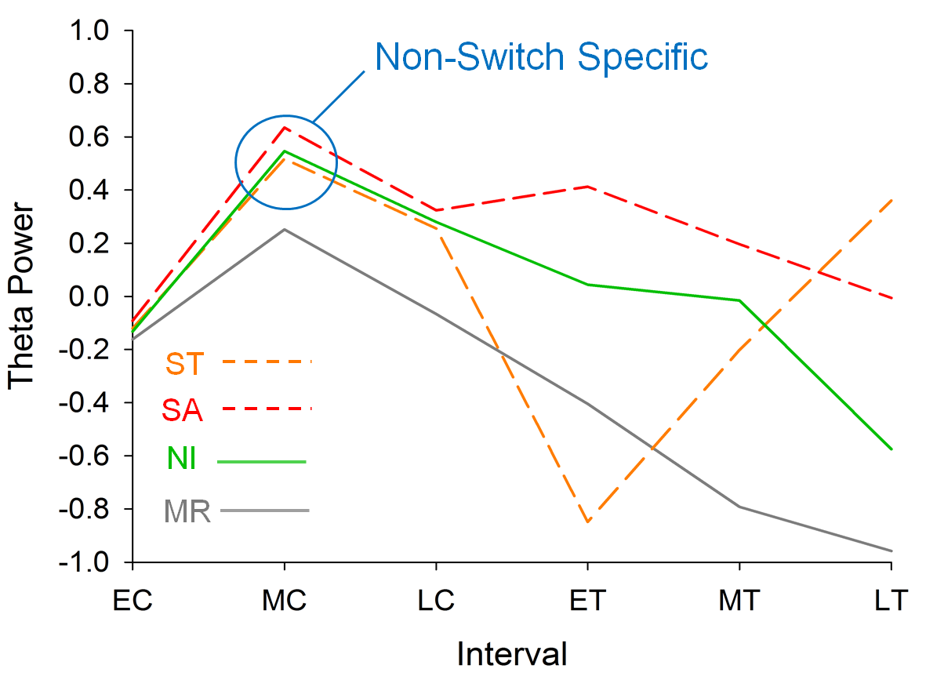


Mid-frontal theta: a measure of attentional processes
indexed during cognitive control
Paul Garrett¹ Patrick S. Cooper^{1,2} & Frini Karayanidis^{1,2}
Paul.Garrett@newcastle.edu.au
¹ Functional Neuroimaging Laboratory, School of Psychology ²Centre for Translational Neuroscience and Mental Health
Background Theta Connectivity Mid Frontal Theta
In Task Switching, Cognitive Control is required for efficient switching between tasks.
In ERP studies, Switching has been associated with a distinct Switch Positivity after Cue. General Negativity at Target is common among Switch and Repeat Conditions¹
Oscillatory activity in the theta band (4-7Hz) is typically associated with cognitive control and has been found in Fronto-Parietal and Mid-Frontal Networks.
Recently Cooper et al.² (submitted) found a distinct Switch Specific Fronto-Parietal network 100-300ms after Cue. However, this effect changed at Target to a General Conflict Resolution Network 900-1100ms after cue
Here we explore Mid-
Frontal Theta (MFT) Power
We aim to assess the nature of MFT in cognitive control at the Cue and Target (n=121); and if these control processes are Switch Specific or if they originate from a more General Cognitive Control system, such as that underlying ERP’s at Target.
Cue
Target
ST v R
SA v R
NI v R
SA v R
Method
Theta Power by Condition
Mixed Repeat Switch To
Initial results show high Theta activity after Cue (0ms) in all conditions, peeking 300ms.
Theta activity tends to decrease during Mid Cue (600ms) in all conditions, and continues this trend through to Late Cue (1000ms).
Switch Away Noninformative
Theta Power by Condition Interval Conclusions
Switch Specific Power is not shown in MFT. This suggests that MFT Is associated with another form of Control.
However, MFT Power at Target does not resemble differences in ERP conditions at Target. This indicates that it is not a General Target Control as we first imagined.
Rather MFT Power may index attentional processes expressed before Cue onset. With greater attentional requirements pertaining to great Theta activity.
This explains the differences between Repeat and Switch and Repeat and Noninformative conditions, while also explaining the inconsistent nature of the Conditional Target interval.
All differences significant at Cue p < 0.01
except MC:
SA-NI and ST-NI
and LC:
SA-ST, SA-NI, ST-NI
All differences significant at Target p <0.01
MR – Mixed Repeat, ST – Switch To, SA – Switch Away, NI – Noninformative,
EC – Early Cue, MC – Mid Cue, LC – Late Cue, ET – Early Target, MT – Mid Target, LT – Late Target
Acknowledgements
The current study was funded by an Australian Research
Council Discovery Project (The Age-ility Project)
We thank Gavin Cooper for programming of the paradigm, Samantha Allen and Montana Hunter for the collection of the data and Aaron Wong, Olivia Whalen and Natalie Lantry for the processing of the data.
References
Cooper et al. 2014.¹
Karayanidis et al. 2009.² Cognitive affect and behavioural neuroscience.

